Slide 1
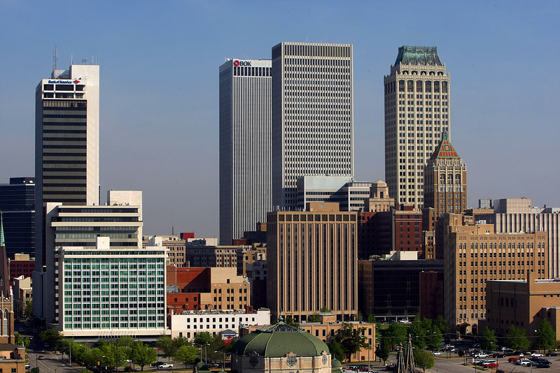
urban8
sales@urban8.com
918.231.2346
..is tulsa
why urban8?

Slide 2
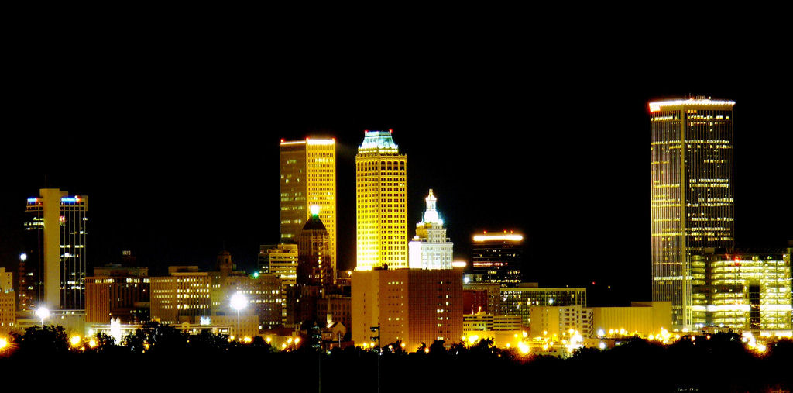
urban8
sales@urban8.com
918.430.5767
…is the next chapter in downtown living
why urban8?

